Slide 1
Trading in Strategic Resources: Necessary Conditions, Transaction Cost Problems, and Choice of Exchange Structure
Tailan Chi (1994)
Strategic Management Journal

Slide 2
Introduction
RBV theorists suggest that strategic resources:
(i) Heterogeneous across firms in an industry
(ii) Imperfectly imitable and imperfectly mobile
(iii) Have no substitutes that are easily imitable or mobile
There has been continuing debate on resources tradability
-- Barney (1986a) maintains that there exist reasonably competitive
markets for strategic resources
-- Dierickx and Cool (1989) submit that unique and valuable resources such as
reputation cannot be readily acquired on a market and thus are not tradable.
Previous research has largely overlooked the means of replicating a resource under the guidance of its present employer.

Slide 3
Research Questions
Under what conditions, if any, can imperfectly imitable and imperfectly mobile resources be gainfully traded across firms?
What are the main difficulties of trading in such resources?
What mechanisms can be used to mitigate the various trading difficulties and how might the exchange structure between the trading parties be affected by adoption of those mechanisms?

Slide 4
Question 1: What are the Conditions for Strategic Resources to be Gainfully Traded
Three component of strategic assets: Physical assets, human skills, and organizational routines
Multiple ways of trading in strategic resources:
Acquisition of the whole firm or part of the firm
Purchase of the resource’s service from the firm that possesses it
Transfer of the skills and organization routines that make up the resource of the firm that presently employs it.
The latter two ways do not remove the resource from the possession (e.g., cross-licensing agreement or joint venture)

Slide 5
Question 1: What are the Conditions for Strategic Resources to be Gainfully Traded
Three component of strategic assets: Physical assets, human skills, and organizational routines
Multiple ways of trading in strategic resources:
Resource Gap
Resource Complementarity
Appropriability of Benefits
The latter two ways do not remove the resource from the possession (e.g., cross-licensing agreement or joint venture)

Slide 6
RBV Theorists’ conjectures regarding Imitability and Mobility
Imperfect imitability: causal ambiguity
Definition: uncertainty about the causal connections between managerial actions and economic results (Lippman & Rumelt, 1982).
Debate: whether the firm employing strategic resources is faced with less causal ambiguity compared to its competitors?
Chi’s (1994) view: The degree of causal ambiguity experienced by the firm possessing the resources does not affect the possibility of trading in but impacts the way the firm chooses to trade in its strategic resources.
Imperfect mobility: specificity
Definition: the condition that a resource is specialized to firm-specific needs so that it has less economically valuable to other firms than to its present employer
Debate: the extent to which strategic resources can be traded across firms.

Slide 7
Chi’s (1994) concept: From mobility to tradability
Mobility concerns the potential that there exists another user to whom the resource’s long-run value is higher than to its present employer (Peteraf, 1993).
Tradability concerns the potential that a possibly temporary use of the resource in conjunction with resources that are not put under the-control of the firm can yield a higher economic return than its present best use within the firm.
Adds more possibilities for inter-firm collaboration.
Identifies four primary transaction cost problems in the trading of strategic resources: adverse selection, moral hazard, cheating, and economic holdup problem.

Slide 8
Two necessary conditions for trading strategic resources
Condition 1
Strategic Resources
+
Strategic Resources
Two firms that possess complementary strategic resources will have an incentive to trade their strategic resources when neither of them expects to be able to exploit the complementarity more profitably by trying to replicated the resources of the other on its own or acquire imperfect substitutes on the open market.

Slide 9
Two necessary conditions for trading strategic resources
Condition 2
Strategic Resources
+
Normal Resources
When there exists complementarity between the strategic resources of one firm and the normal resources of another firm, the two firms will have an incentive to trade the strategic resources (a) if the former does not expect to be able to exploit the complementarity more profitably by acquiring the normal resources on the open market; and(b) if the latter does not expect to be able to exploit the complementarity more profitably by trying to replicate the strategic resources of the former on its own or acquire imperfect substitutes on the open market.

Slide 10
Question 2: What are the barriers to imitation and impediments to trading?
Linking the barriers to imitation with the transaction costs to trading
Sources of imperfect imitability:
Tacitness characterizes skills and organization routines whose creation and replication heavily rely on learning by doing (Penrose, 1959; Polanyi,1967).
Complexity arises from the existence of many different and interrelated skills and organization routines within a firm (Nelson & Winter, 1982).
Specificity refers to the condition that a resource is specialized to the needs of specific transactions (Williamson, 1985).

Slide 11
Question 2: Barriers to imitation and impediments to trading
Information asymmetry
Causal ambiguity
Adverse selection (Akerlof, 1970)
Measurement problem
Tacitness
Moral Hazard (shirking)
If the mean of trading is not acquisition, the transaction costs also includes the costs of coordinating interdepend complementary resources between two firms:
Cheating in ex ante contractible aspects of coordination
Complexity and Specificity
Holdup in ex ante noncontractible aspects of coordination

Slide 12
Question 3: Structural Remedies for Transaction Cost Problems

Slide 13
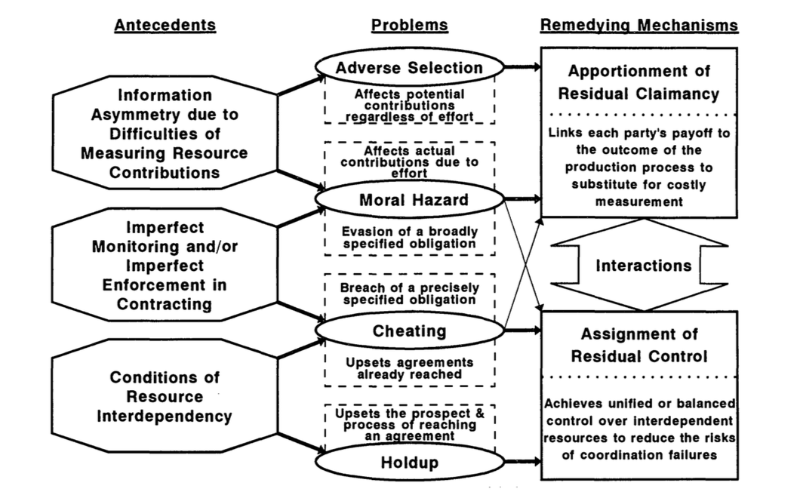
Overview of problems and remedies

Slide 14
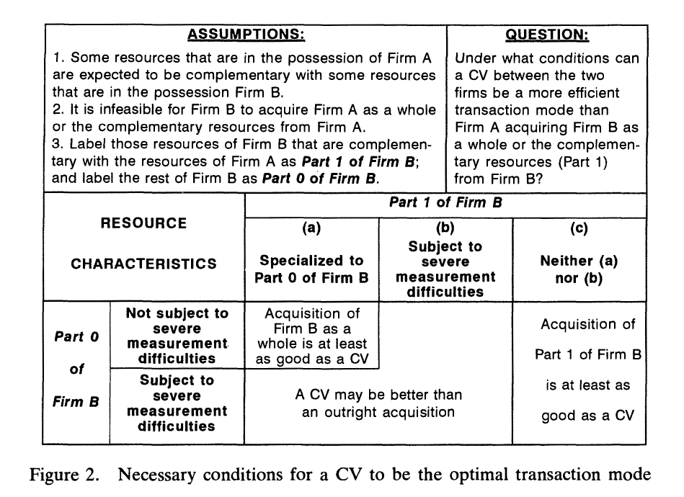
Implication: Trading Modes Choice between Acquisition and Collaborative Venturing

Slide 15
Contributions
It incorporates resource-based, property rights, and transaction costs perspectives.
The definition of trading in strategic resources is broader than the concept of mobility.
A two-dimensional perspective of the exchange structure is proposed in this journal article.

